Slide 1
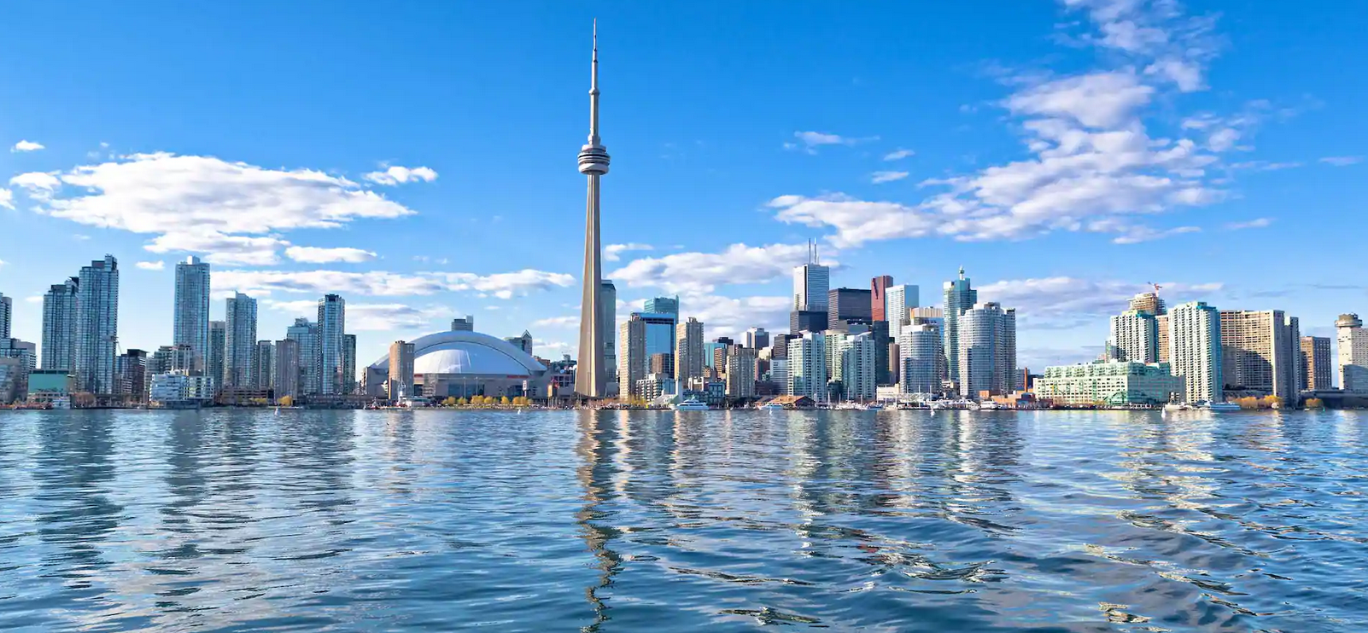
Capstone Project
The battle of neighborhood – does living in downtown work for everyone?

Slide 2
Introduction
Immigrants of Toronto
Downtown? Or Suburbs?
Rent/Convenience

Slide 3
data
Postal codes, borough and neighborhood of Toronto from Wikipedia page
Python geometry library
Foursquare API
Apartment renting websites

Slide 4
Methodology
Scrape and clean data
Map the neighborhood using folium
Find the most common nearby venues using Foursquare
Kmeans Clusters

Slide 5
Results
Top 3 categories: coffee shops, clothing stores and hotels
Cluster 0: Coffee Shops Cluster 1: Parks Cluster 2: Grocery Store
High rent
Less convenient

Slide 6
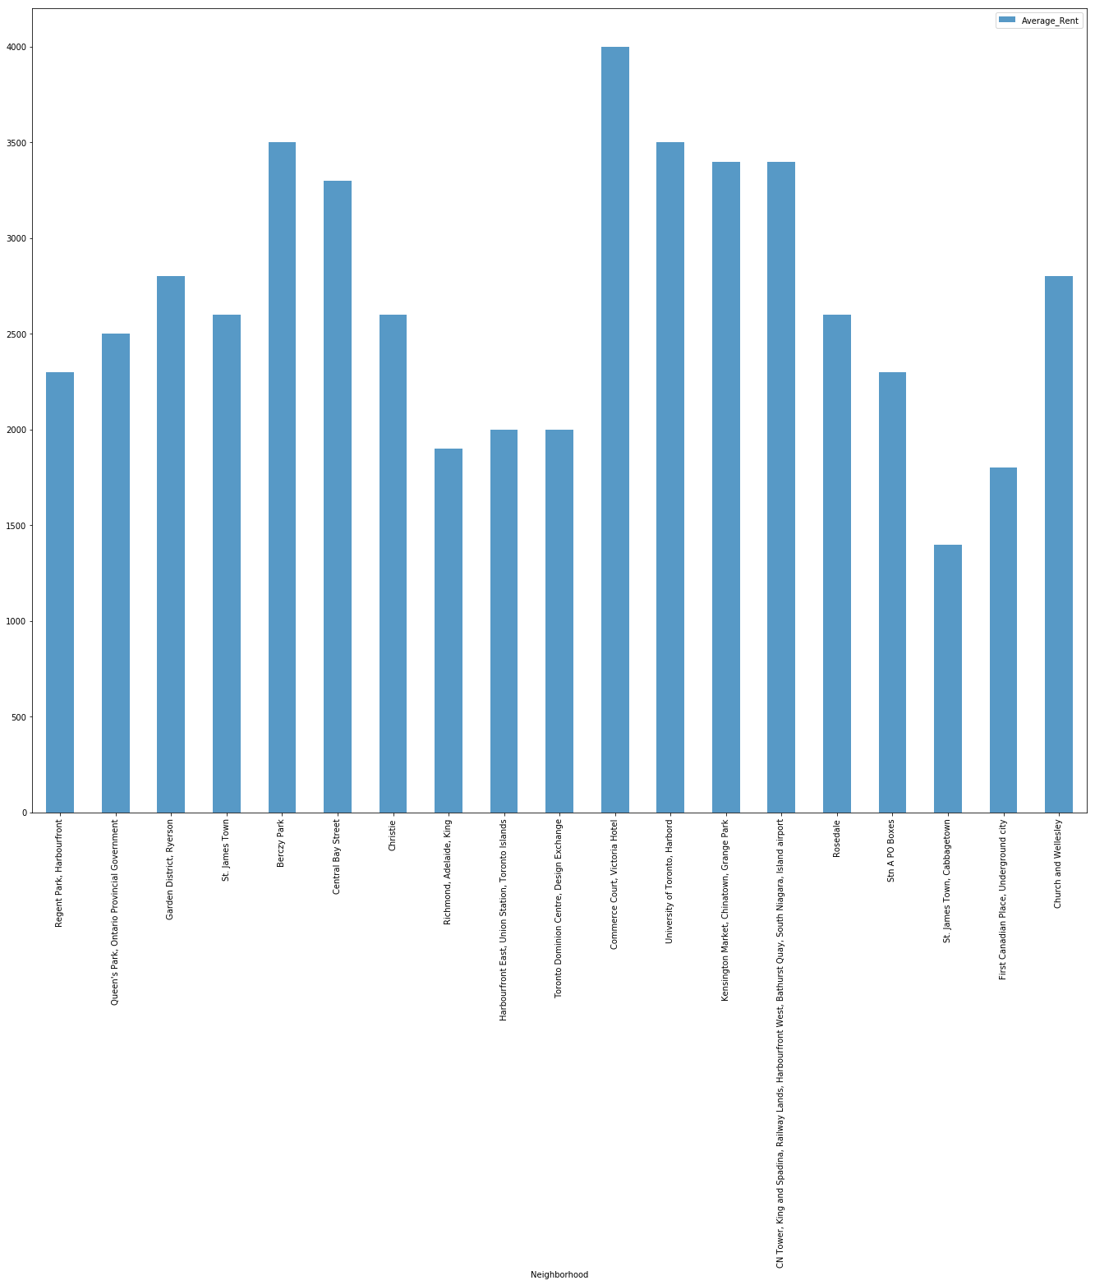

Slide 7
Discussion & Conclusion
More social places than living essentials
Not suitable for immigrant families with many members
Living in downtown does not work for most immigrant families
Christie can be a good location
Future problem: locate a new restaurant

